Slide 1

C# Advanced – Class 1
Material recap: Loops, Collections, Enums, Classes, Getters and Setters, Constructors
New material: Indexers, Copy and Clone constructors
Trainer: Igor Micev
Assistant: Dejan Jovanov
Code academy @ Skopje, 2019

Slide 2
Warm up
C# Advanced - Day 01
Variables, data types
Constants, Enums
Branching
Iterations (Loops)
Collections
Classes
Indexers (new)
Constructors (recap + new)

Slide 3
Variables and data types
C# Advanced - Day 01
Variables
A variable is nothing but a name given to a storage area that our programs can manipulate.
Each variable has a specific type, which determines the size and layout of the memory, the range of values that can be stored within that memory and the set of operations that can be applied to the variable.
int i = 0; int @int = 0 //this is possible too
string x = ”Hello World”;
Data types
Data type tells a C# compiler what kind of value a variable can hold. C# includes many in-built data types for different kinds of data (string, int, double, decimal …)

Slide 4
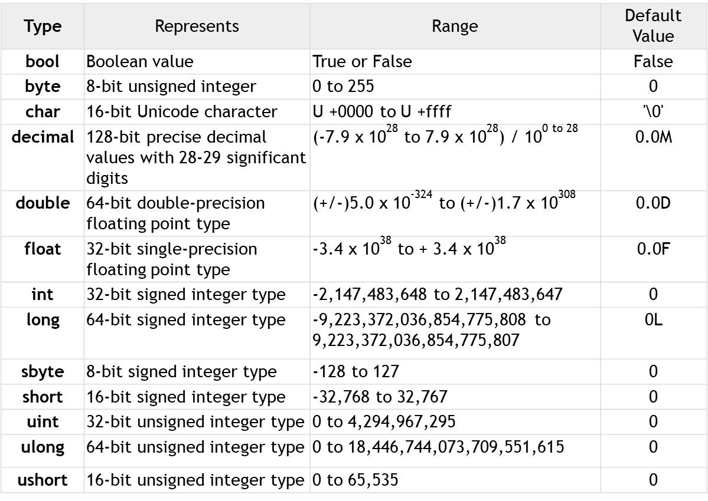
Variables and data types (2)
C# Advanced - Day 01

Slide 5
Constants and Enums
C# Advanced - Day 01
Constants
Constants are fields whose values are set at compile time and can never be changed.
const double Pi = 3.14;
Enums
Sets of distinct named constants
Logical connection among various constants
enum DaysOfWeek {Monday, Tuesday, Wednesday, Thursday, Friday, Saturday, Sunday}
DEMO

Slide 6
Branching
C# Advanced - Day 01
Unconditional - happens every time the branch point is reached (unconditionally)
Method Call()
Break
Continue
GoTo
Conditional - based on the evaluation of certain conditions that occur at runtime
Short-Circuit Evaluation - If first term is false in the complex condition, the compiler will short-circuit the evaluation, the second test will never be performed
If
If Else
Else If
Switch

Slide 7
Iterations (Loops)
C# Advanced - Day 01
Loops
While
Do While
For
Loop with GO - Spaghetti Code, experienced programmers usually avoid using goto to create loops

Slide 8
Collections
C# Advanced - Day 01
Generics
Array – fixed size
List – dynamically increased
Dictionary – key, value pair, (unordered)
Queue – FIFO, (unordered)
Stack – LIFO, (unordered)
Exercise – Write a program that will receive an input from a console application that will give the capital city of a country. Previously the list should be built-in into a suitable structure (choose one from above).

Slide 9
The Object class in C#
object == Object
This type is simply an alias of System.Object
Every class inherits from the Object class. It’s the base class in C#.
Exercise and demo:
Equals ()
ReferenceEquals ()
GetType ()
GetHashCode ()
ToString ()

Slide 10
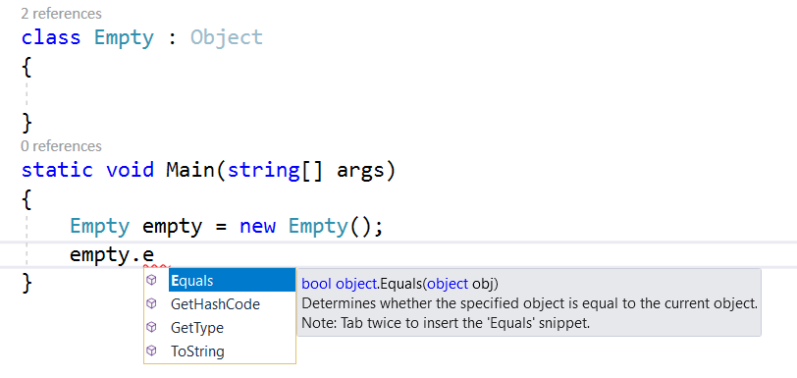
The Object class in C#
C# Advanced - Day 01
Supports all classes in the .NET Framework class hierarchy and provides low-level services to derived classes. This is the ultimate base class of all classes in the .NET Framework; it is the root of the type hierarchy.
Demo
Equals()
GetHashCode()
GetType()
ToString()

Slide 11
Getters and Setters - recap
C# Advanced - Day 01
Demo
Class1 – shortest way of using getters and setters
Class2 – shorter way of using getters and setters
Class3 – the traditional/old way of using getters and setters

Slide 12
Indexers for classes
C# Advanced - Day 01
Indexers allow instances of a class or struct to be indexed just like arrays. The indexed value can be set or retrieved without explicitly specifying a type or instance member.
When a class has an indexer it can be used in a similar manner as array. Objects of the class can use array-style notation to present multiple values.
An indexer allows an object to be indexed such as an array. When you define an indexer for a class, this class behaves similar to a virtual array.
Demo1
Demo2

Slide 13
Constructors and Finalizers (Destructors)
Constructor is public
You can create as many constructors as you need
They can have arguments
Not necessary to create within the class (just for info, not common in practice)
Destructor is invisible for the user (not private)
No arguments
Only one destructor per class
Must start with (~)
Not necessary to create within the class (just for info, not common in practice)

Slide 14
Constructors - overview
C# Advanced - Day 01
Instance constructor
The “default” constructor for the classes
Private constructor
It’s a special instance of the instance constructor. You cannot instantiate an object because the constructor is private.
Static constructor
This constructor is used to initialize any static data, or to perform one-time action, like setting constants values.
Copy constructor
There is no “Copy” constructor, but a way to make simulation. That constructor is called Copy constructor.
Clone constructor
Implements the class must implement the ICloneable interface in order to overload the Clone() method. (p.s. Interfaces are coming on next class)

